Slide 1
Chasing Robots Challenge
Venkat Raman

Slide 2
Problem Statement
Online Auction Site has both Human and Bot bidders. As a result human bidders are getting frustrated with their inability to win auctions which is leading to customer base plummeting
So, using Machine Learning techniques to identify auction bids placed by bots and help owners to flag these bot accounts for removal from site to prevent unfair auction activity

Slide 3
Datasets
There are two datasets in this task. One is a bidder dataset that includes a list of bidder information, including their id, payment account, and address. The other is a bid dataset that includes 7.6 million bids on different auctions.
For the Bidder dataset
bidder_id ,payment_account , address , outcome
For the Bid dataset
bid_id, bidder_id (join key),auction, merchandise ,device ,
time ,country ,ip ,url

Slide 4
Problem statement and Hypothesis Generation
Since there are bots with human bidders in the online auction site it is a binary classification tasks
Since the dataset does not have lot of features we have build features to make meaningful predictions
Hypothesis :
The bots should have these Characteristics:
They bid in short period of time
They have large number of bids when compared with human counterparts
They can bid faster than humans
They can bid during midnight hours

Slide 5
Data Exploratory Analysis
The missing values in the dataset is less than 0.1% for 7 variables.
There were 9 object type variables in the datasets for which label encoding was done, because the number of categories for each variable was higher
The dataset is bidder_id and time sorted to create features with time data
The target variable is skewed & not balanced only 10% of the users in the site is bot
The dataset has data from three time chunks
Based on plots, there is some separation with variables like device, merchandise, country with respect to target

Slide 6
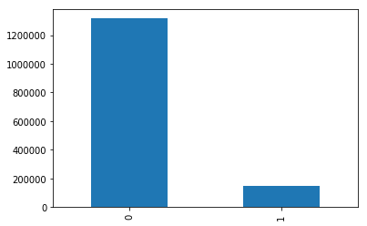
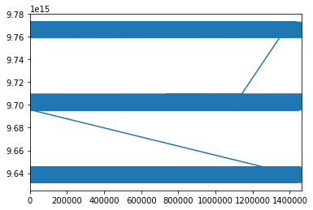
Exploratory Data analysis 1
Target Variable is not equally distributed and only 10% of the bids are done by bots(image 1)
The dataset has time from 3 time chunks(image 2)

Slide 7
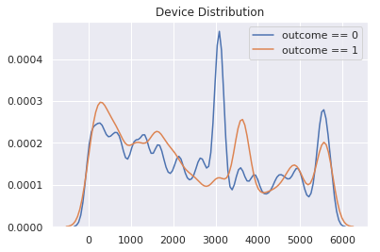
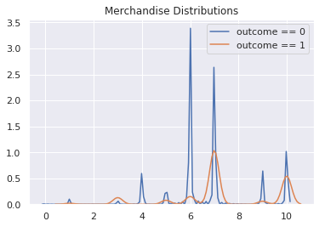
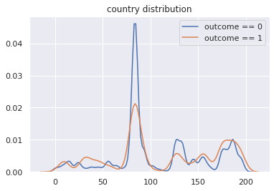
Exploratory Data analysis 2
I have plotted the distribution with respect to target
From Device Plots has better separation with the output variable which the model should capture
From Merchandise Plots we can conclude that only certain items has only bids from bots
From Country distribution we can see that bots are present from all country.

Slide 8
Feature Creation
Based on the hypothesis generated we have created features
Count of bids by each bidder
Count of bids per auction by each bidder
Time difference between each bids
Time difference between each bids per auction
Hour of the day
Day of the week
Day of the month
Max, Mean, Min time difference between each auction per bidder
Max, Mean, Min time difference between each bidder

Slide 9
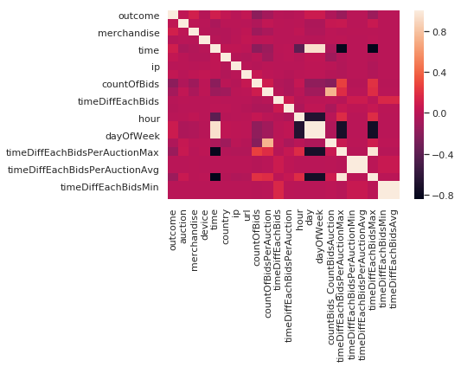
Correlation analysis

Slide 10
Correlation analysis Results
From correlation analysis,
Count of bids, Time difference between bids per auction and max time difference between each bid are highly negative correlated
URL,Merchandise and country are highly positive correlated
Time difference is negatively correlated saying us that shorter bids are made by bots
Which proves us that variables which we have created are correlated with the target proving those variables are useful

Slide 11
Model Creation
For Unbalanced Binary classification tasks accuracy cannot be used as a metric. Since both Recall and Precision has to be taken into account, F1 score and AUC ROC is the metric chosen to evaluate model
The models considered for problem
A. Logistic Regression
B. Random Forest
C. Gradient boosting Classifier Trees

Slide 12
Model Selection
The initial Logistic regression model did not converge.So, I did not proceed with this model so performance was poor
Used Random Forest and found default random forest model with no cross validation is found to be overfit
So went ahead with GBDT model in sklearn library with grid search parameters and scoring used was ‘f1 score’
Finally cv results were analyzed and the final model was developed with the parameters

Slide 13
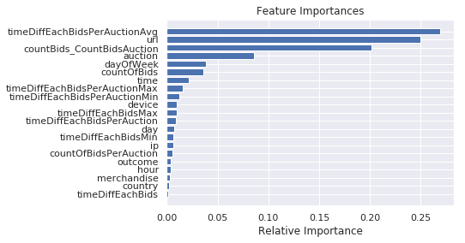
Feature importance of variables

Slide 14
Conclusion
Finally the Sklearn GBDT model was selected and the best model has an f1 score of about 0.97
A lot of hypothesis which we assumed were true. The importance features were average time between auction, count of bids, URL referred ,auction items, day of week, country
Thus by deploying the model the site owners should be able to prevent the bots from bidding in the site

